Slide 1
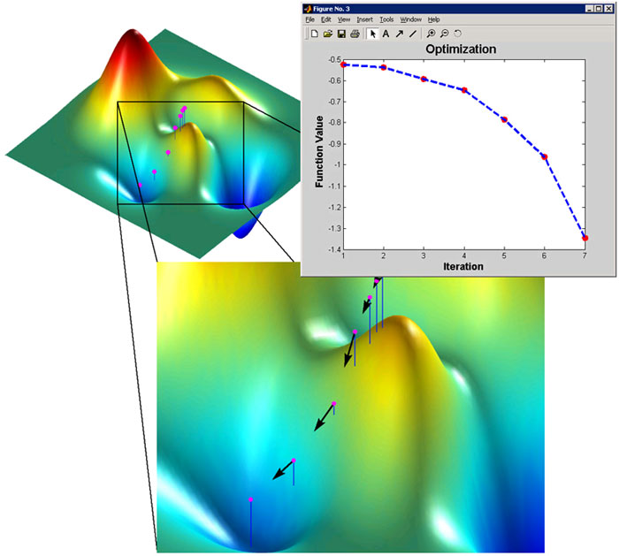
Optimization II

Slide 2
Conjugate Gradient (CG) Method
Another method does not require explicit second derivatives, and does not even store approximation to Hessian matrix
CG generates sequence of conjugate search directions, implicitly accumulating information about Hessian matrix
For quadratic objective function, CG is theoretically exact after at most n iterations, where n is the dimension of problem

Slide 3
Conjugate Directions
Pick a set of directions:
d₍₀₎, d₍₁₎ , … , d_{(n-1)}
Take exactly one step along each direction
Solution is found within n steps
Two problems:
how do we determine these directions?
how to we determine the step size along each directions?

Slide 4
How do we determine the optimal step size?
Suppose we know the CG directions for now, we want to know the optimal step size in each CG direction?

Slide 5
Conjugacy (A-orthogonality)
If we take the optimal step size along each conjugate direction
Two vectors v and u are conjugate or A-orthogonal if v^{T}Au=0

Slide 6
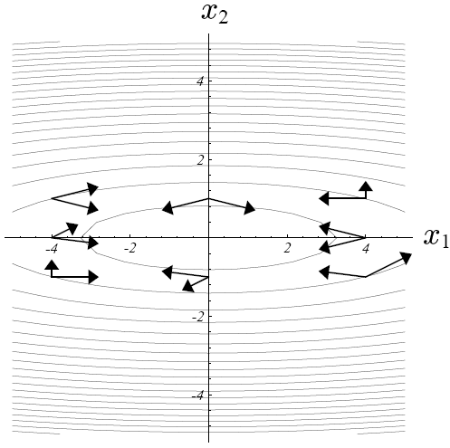
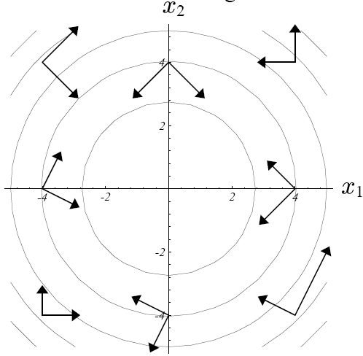
A-orthogonality vs. Orthogonality
A-orthogonal vectors
orthogonal vectors

Slide 7
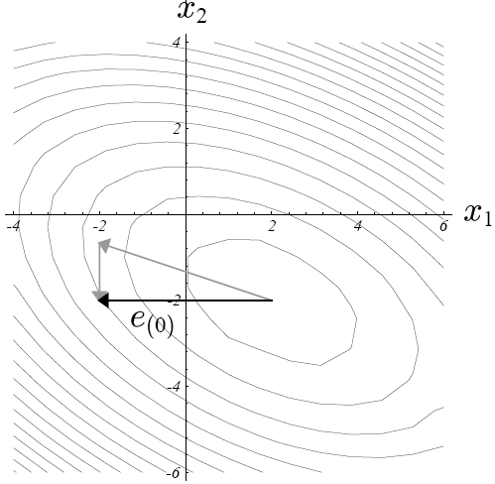
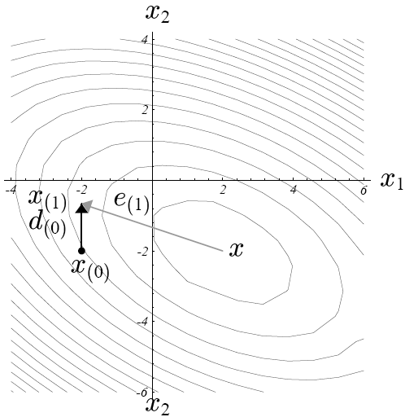
Optimal Step Size
Use this condition, can you derive α_{(k)} ?

Slide 8
Algorithm
Suppose we can come up with a set of A-orthogonal directions {d_{(k)}}
1. Take d_{(k)}
2.
3.

Slide 9
Why does it work?
We need to prove that x* can be found in n steps if we take α_{(k)} step size along d_{(k)} at each step
d’s are linearly independent
if d’s are conjugate
See proof in next slide

Slide 10
Proof that
…

Slide 11


A-orthogonality (cont.)

Slide 12
Error term vanishes after n steps
After n steps, e_{(n)} = 0
The error at step j is equal to
(1) e₍₀₎ + total path of previous j-1 steps traveled
(2) total path of next n-j steps that are going to be traveled
Notes:
The error at step j is equal to
1) e(0) + total path of previous j-1 steps traveled
2) total path of next n - j steps that are going to be traveled

Slide 13
Search Directions
We know how to determine the optimal step size along each direction
We still need to figure out what search directions are
What do we know about d₍₀₎, d₍₁₎ , … , d_{(n-1)} ?
They are A-orthogonal to each other: d_{(i)}^{T}Ad_{(j)} = 0
d_{(i)} is A-orthogonal to e_{(i+1)}

Slide 14
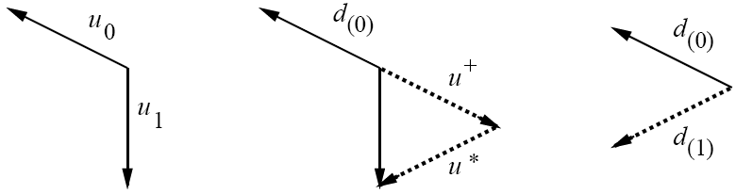
Gram-Schmidt Conjugation
Suppose we have a set of linearly independent vectors u₀, u₁ , … , u_{n-1}
To construct d_{(i)}, take u_{i} and subtract out any components that are not A-orthogonal to the previous d vectors:
d₍₁₎ = u₁ - u⁺

Slide 15
Gram-Schmidt Conjugation
The search directions can be represented as
Use the same trick to get rid of the summation
by A-orthogonality of d vectors

Slide 16
Drawbacks of Gram-Schmidt Conjugation
All the old search vectors must be kept in memory to construct each new one!
Remedy → conjugate gradients

Slide 17
Conjugate Gradients
If we pick a set of u’s intelligently, we might be able to save both time and space
It turns out that residuals (r’s) is an excellent choice for u’s
residual is orthogonal to the previous search direction
residuals work for steepest descent

Slide 18
Conjugate Gradients (cont.)
Gram-Schmidt Conjugation
In conjugate gradient method, search directions are constructed by conjugation of the residuals

Slide 19
Conjugate Gradients (cont.)
Take and subtract out any components that are not A-orthogonal to the previous d vectors
by A-orthogonality of d vectors

Slide 20
Conjugate Gradients (cont.)
r_{(k)} is A-orthogonal to all the previous search directions except for d_{(k-1)}
Proof:
We don’t need to store previous search directions now!

Slide 21
Proof: Orthogonality
Proof: r_{(k)} is orthogonal to all the previous search directions d₍₀₎ , d₍₁₎ , …, d_{(k-1)}
From here, we can prove
(see page 29-30 of Shewchuk’s paper)
Notes:
As each residual is orthogonal to the previous search directions, it is also orthogonal to the previous residuals.
Because the search vectors are built from the residuals, the subspace span {d0, d1, d_k-1} is the same as the one span {r0, r1, …, r_k-1}

Slide 22
Proof: A-Orthogonality
r_{(k)} is A-orthogonal to all the previous search directions except for d_{(k-1)}

Slide 23
Conjugate Gradients
Recall in slide 19,
And the results in slide 22,
(from last slide)
From slide 9:

Slide 24
Conjugate Gradients
Put it all together
(from slide 23)

Slide 25
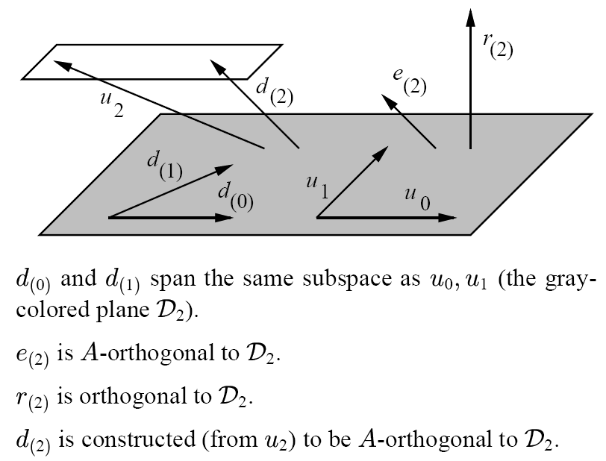
Geometric Interpretation

Slide 26
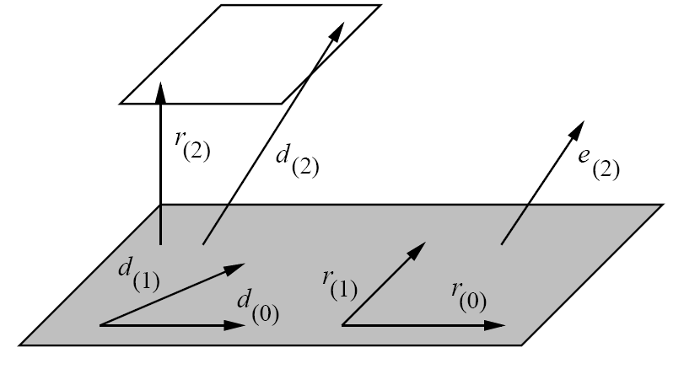
Each new residual is orthogonal to all the previous residual and search directions
Each new search direction is constructed from the residual to be A-orthogonal to all previous residuals and search directions

Slide 27
Example:
Minimize f(x,y)=1.5*x^2+2*x*y+3*y^2-2*x+8*y
http://www.cse.uiuc.edu/iem/optimization/ConjugateGradient/

